Slide 1




VRELAX INVESTIGATION OF RELAXING
Görkem Narinoğlu & Umut Efiloğlu
Advisor: Dr. Faris Serdar Taşel
Co-Advisor: Assist. Prof. Dr. Murat Yılmaz

Slide 2
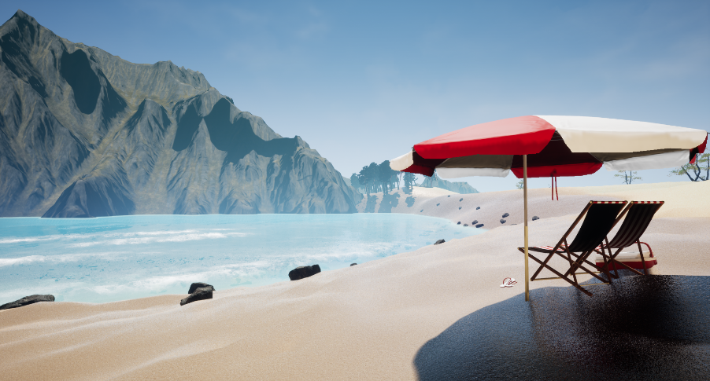
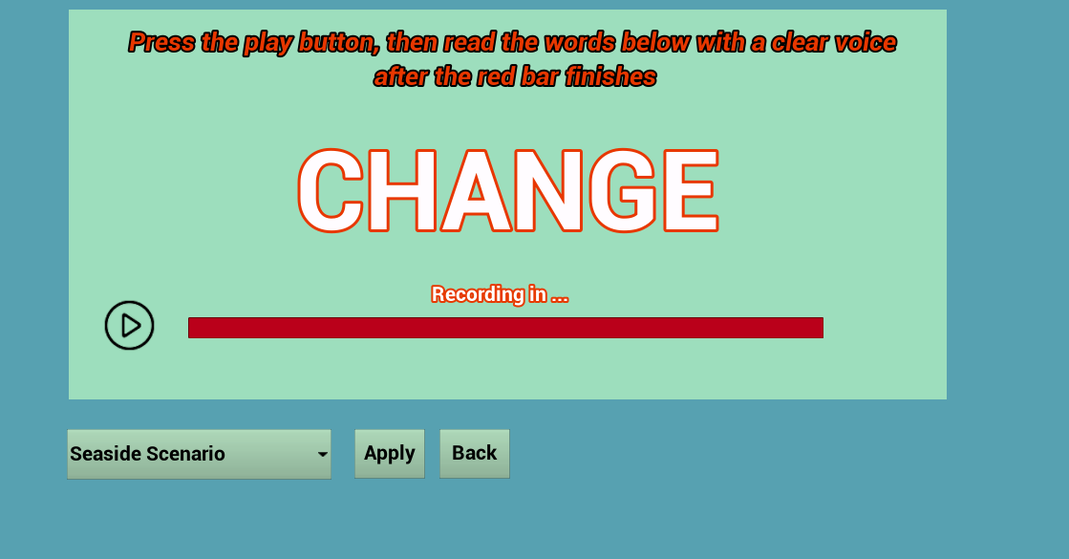
VRelax Investigation of Relaxing
A VR/Desktop application that involves stress analysis and relaxing scenarios
Main Features
Stress analysis with voice & feedback
Relaxing and enjoyable environments
Realistic graphics
Soothing ambiance
Both desktop and VR compatible

Slide 3
Main Contribution Pros and Cons to Similar Projects
 | RelaxVR | MonarchVR | Atmosphaeres | VRelax: IoR
Compatibility | iOS & Android VR (Gear VR etc.) | Android VR (Gear VR etc.) | Android VR (Gear VR etc.) | Desktop VR (HTC Vive etc.)
Price & Availability | $2.99 | $0.99 | Free (in-app purchases starting from $1.99) | Free & Open Source
Graphics Quality | Real Locations with 360° videos | 3D Virtual Environment | Real Locations with 360° videos | 3D Virtual Environments
User Interactions | No Interactions | No Interactions | No Interactions | Possible to interact with the world
Stress Analysis Feature | Not Available | Not Available | Not Available | Available
Sound Design | Music & Ambiance Sounds | Music & Ambiance Sounds | Music & Ambiance Sounds | Ambiance Sounds
Environment Variety | 10 Different Environments | 1 Environment | 5 Different Environments | 2 Different Environments

Slide 4
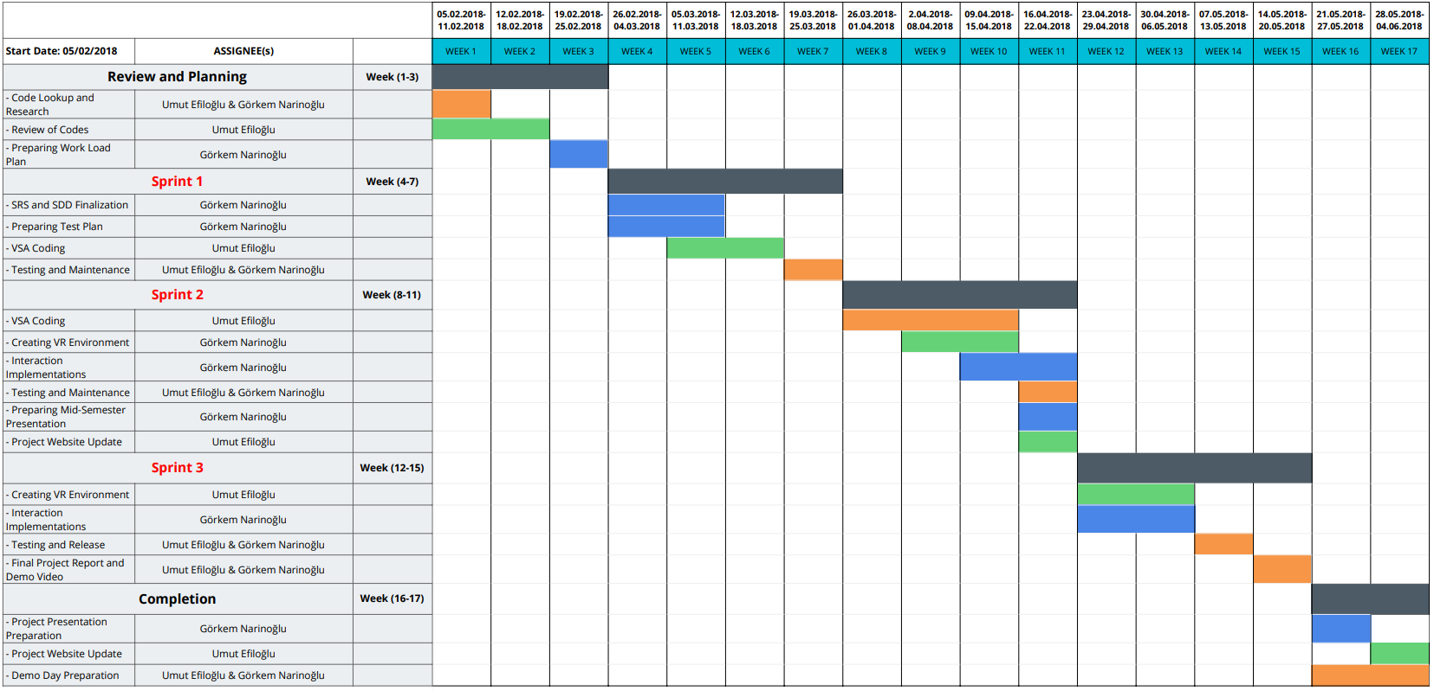
Workplan

Slide 5
Success Criterion
Success Criterion | How to Measure
User Relaxation | Measuring stress level with the VSA tool again and psychologist can confirm for double check
Sense of Reality | User feedbacks
Stress Test Validity | Validity check according to literature and emotional database stress readings (SUSAS) or psychologists' feedback about user's stress level

Slide 6
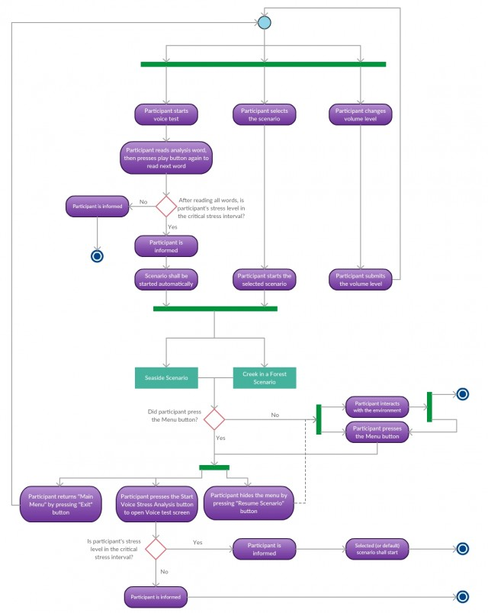
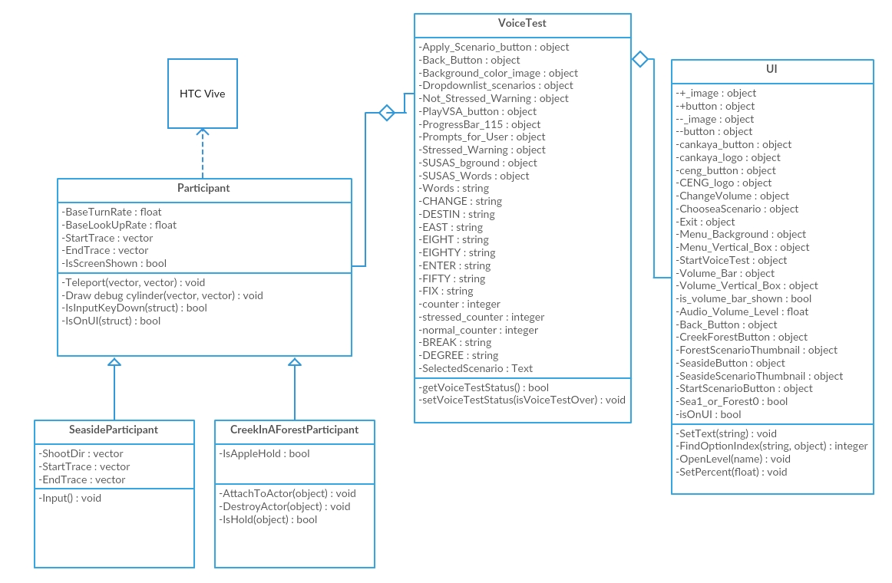
Materials and Methods
Ensemble Empirical Mode Decomposition (libeemd)
Hilbert Huang Transform & GNU Scientific Library
Unreal Engine Objects, Materials & Various Assets

Slide 7
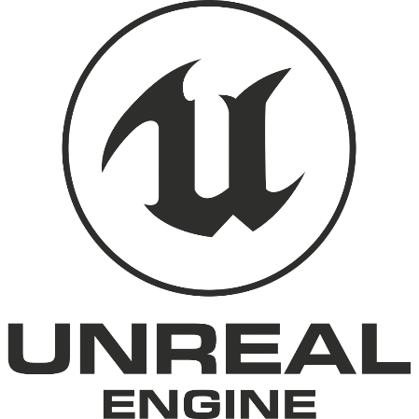


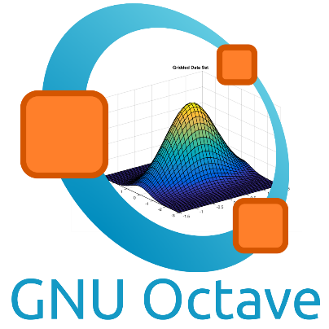

Technology Used
Here are the tools that we used;
Unreal Engine
Oculus Rift
MATLAB / Octave
Visual Studio

Slide 8
Defect Density
Sprints | % Approx. Defect Impacts on App*
Sprint 1 | ~80
Sprint 2 | ~40
Sprint 3 & Release | ~10
*Defect Impact measured by defected components divided by total components

Slide 9
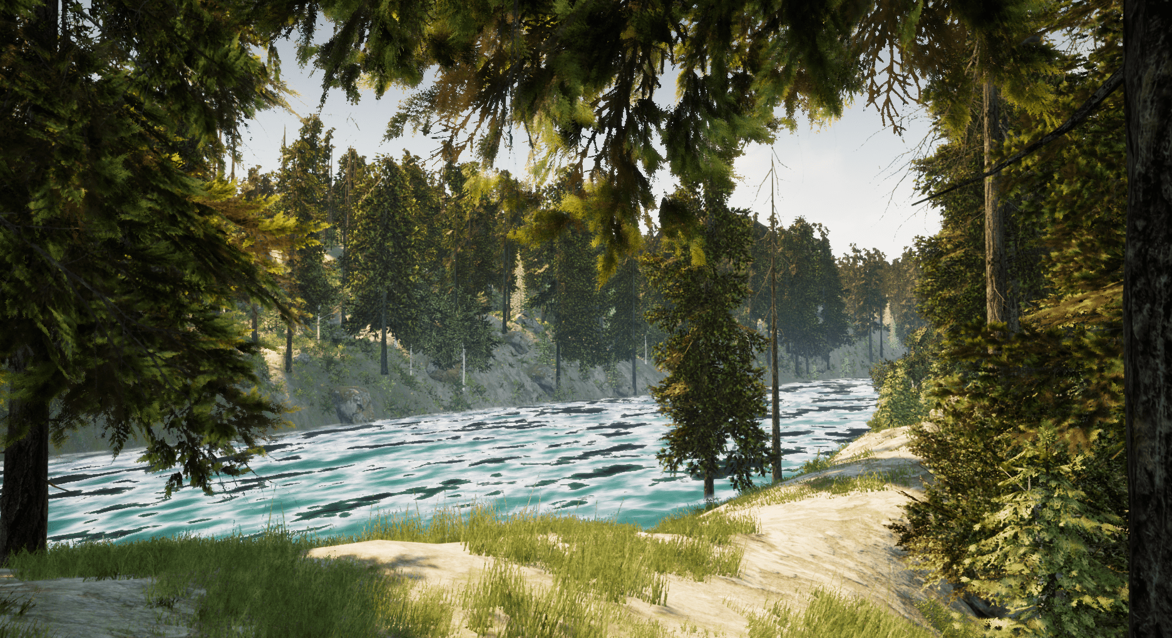
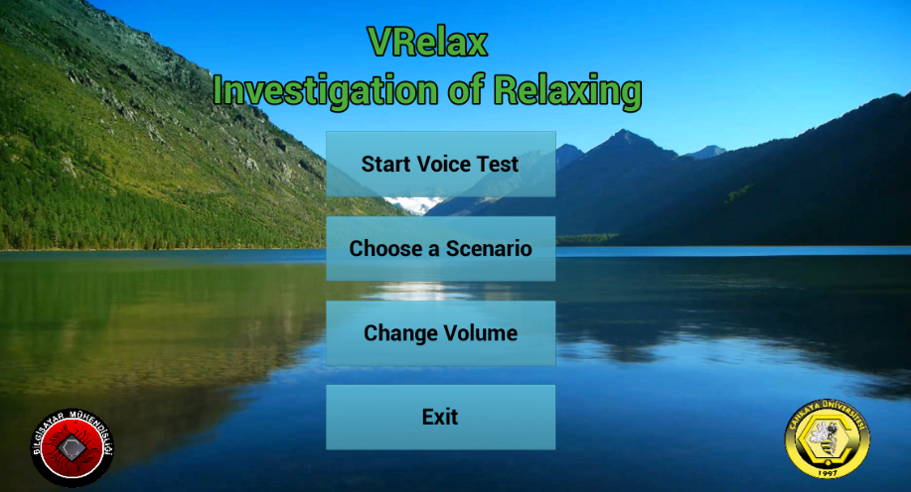
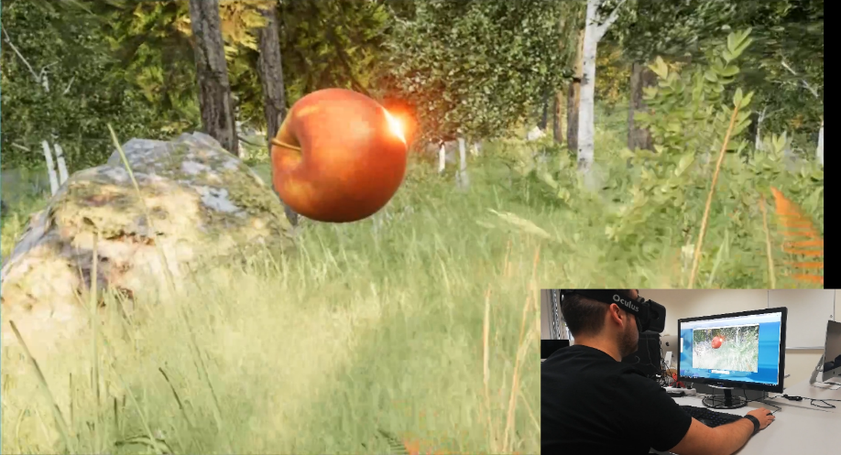
Screenshots of the Project

Slide 10

Any Questions?

Slide 11
Potential Risks and Impacts
Risks | Prequations | Potential Impact | Plan B | % Implication
Reading wrong word or doesn’t reading all words in voice stress analysis | Right analysis word is prompted on the screen and voice analysis application does not start without button press | Stress with voice can not be processed properly | Psychologists warn the user | High
Experiencing health problems after long-term usage of VR headset | Health and Safety warnings and possible issues are stated in User Manual | User can suffer serious health problems | Psychologists terminate the application | High
User has lack knowledge of usage of VR headset and application | User Manual is provided | User can not execute and/or use the application properly | Demo video is prepared | Medium

Slide 12
Why HTC Vive?
Fully supports Unreal Engine
Has wide view angle and its technical features are better than its counterparts.
Proposer company has HTC Vive

Slide 13
Why Oculus Rift?
For testing purposes
VR Lab have Oculus Rift
Gives satisfying results

Slide 14
Theoretical Test Results
EEMD RESULTS |  |  |  |  |  |  |  |  | EEMD RESULTS
 |  |  | NORMAL SOUNDS |  |  |  |  |  |  |  |  | STRESSED SOUNDS
 |  |  | NORMAL |  | STRESSED |  | RESULTS |  |  |  |  | NORMAL |  | STRESSED |  | RESULTS
NAME |  |  | sum(d>=8 & d<=12) |  | sum(d>=12 & d<=17) |  |  |  | NAME |  |  | sum(d>=8 & d<=12) |  | sum(d>=12 & d<=17)
eemd_Normal_CHANGE1_N_3 |  |  | 1240 |  | 529 |  | TRUE |  | eemd_Stressed_CHANGE1_N_3 |  |  | 8884 |  | 4628 |  | FALSE
eemd_Normal_CHANGE1_N_4 |  |  | 8695 |  | 3364 |  | TRUE |  | eemd_Stressed_CHANGE1_N_4 |  |  | 4615 |  | 8798 |  | TRUE
eemd_Normal_CHANGE1_N_5 |  |  | 4730 |  | 6389 |  | FALSE |  | eemd_Stressed_CHANGE1_N_5 |  |  | 405 |  | 1117 |  | TRUE
eemd_Normal_DESTIN1_N_3 |  |  | 6364 |  | 2002 |  | TRUE |  | eemd_Stressed_DESTIN1_N_3 |  |  | 4906 |  | 4687 |  | FALSE
eemd_Normal_DESTIN1_N_4 |  |  | 12625 |  | 8379 |  | TRUE |  | eemd_Stressed_DESTIN1_N_4 |  |  | 10831 |  | 6064 |  | FALSE
eemd_Normal_DESTIN1_N_5 |  |  | 9758 |  | 20194 |  | FALSE |  | eemd_Stressed_DESTIN1_N_5 |  |  | 4139 |  | 9480 |  | TRUE
eemd_Normal_EAST1_N_3 |  |  | 6147 |  | 2722 |  | TRUE |  | eemd_Stressed_EAST1_N_3 |  |  | 2771 |  | 1988 |  | FALSE
eemd_Normal_EAST1_N_4 |  |  | 6730 |  | 5205 |  | TRUE |  | eemd_Stressed_EAST1_N_4 |  |  | 6541 |  | 5606 |  | FALSE
eemd_Normal_EAST1_N_5 |  |  | 1365 |  | 4767 |  | FALSE |  | eemd_Stressed_EAST1_N_5 |  |  | 3225 |  | 8601 |  | TRUE
eemd_Normal_EIGHT1_N_3 |  |  | 1104 |  | 414 |  | TRUE |  | eemd_Stressed_EIGHT1_N_3 |  |  | 2556 |  | 1867 |  | FALSE
eemd_Normal_EIGHT1_N_4 |  |  | 6186 |  | 2799 |  | TRUE |  | eemd_Stressed_EIGHT1_N_4 |  |  | 7624 |  | 4854 |  | FALSE
eemd_Normal_EIGHT1_N_5 |  |  | 3513 |  | 7741 |  | FALSE |  | eemd_Stressed_EIGHT1_N_5 |  |  | 4068 |  | 10730 |  | TRUE
eemd_Normal_EIGHTY1_N_3 |  |  | 1864 |  | 858 |  | TRUE |  | eemd_Stressed_EIGHTY1_N_3 |  |  | 2215 |  | 1222 |  | FALSE
eemd_Normal_EIGHTY1_N_4 |  |  | 14562 |  | 5742 |  | TRUE |  | eemd_Stressed_EIGHTY1_N_4 |  |  | 7212 |  | 3103 |  | FALSE
eemd_Normal_EIGHTY1_N_5 |  |  | 6359 |  | 9357 |  | FALSE |  | eemd_Stressed_EIGHTY1_N_5 |  |  | 7700 |  | 10737 |  | TRUE
eemd_Normal_ENTER1_N_3 |  |  | 4734 |  | 1707 |  | TRUE |  | eemd_Stressed_ENTER1_N_3 |  |  | 3808 |  | 1614 |  | FALSE
eemd_Normal_ENTER1_N_4 |  |  | 13077 |  | 5356 |  | TRUE |  | eemd_Stressed_ENTER1_N_4 |  |  | 6184 |  | 13364 |  | TRUE
eemd_Normal_ENTER1_N_5 |  |  | 3772 |  | 7057 |  | FALSE |  | eemd_Stressed_ENTER1_N_5 |  |  | 878 |  | 2820 |  | TRUE
eemd_Normal_FIFTY1_N_3 |  |  | 795 |  | 281 |  | TRUE |  | eemd_Stressed_FIFTY1_N_3 |  |  | 6151 |  | 2374 |  | FALSE
eemd_Normal_FIFTY1_N_4 |  |  | 2961 |  | 265 |  | TRUE |  | eemd_Stressed_FIFTY1_N_4 |  |  | 8657 |  | 9984 |  | TRUE
eemd_Normal_FIFTY1_N_5 |  |  | 8867 |  | 7082 |  | TRUE |  | eemd_Stressed_FIFTY1_N_5 |  |  | 866 |  | 2507 |  | TRUE
eemd_Normal_FIX1_N_3 |  |  | 1784 |  | 356 |  | TRUE |  | eemd_Stressed_FREEZE1_N_3 |  |  | 8796 |  | 5997 |  | FALSE
eemd_Normal_FIX1_N_4 |  |  | 8942 |  | 3810 |  | TRUE |  | eemd_Stressed_FIX1_N_4 |  |  | 9336 |  | 11216 |  | TRUE
eemd_Normal_FIX1_N_5 |  |  | 13178 |  | 6742 |  | TRUE |  | eemd_Stressed_FIX1_N_5 |  |  | 464 |  | 922 |  | TRUE

